Slide 1
Non-drug Approaches for Care Partners to Use When a Loved One Living with LBD has Behavioral Changes
Rosemary Dawson, Ed.D.
Helen Buell Whitworth, MS, BSN
James Whitworth, LBDA Co-founder

Slide 2
International Lewy Body Dementia Conference
Caesars Palace, Las Vegas, NE
June 25-27, 2019
Sponsored by the Cleveland Clinic

Slide 3
Behavioral and Mood Changes

Slide 4
Behavioral and Mood Changes
Experienced by most people living with LBD
Can begin very early in the disease, show up later, or both
Vary from person to person, from benign to intrusive to disturbing
Some types are more common than others
Greatly increase care partner burden

Slide 5
Behavioral and Mood Changes
Auditory hallucinations ─ false perceptions of sound such as buzzing, knocking, background music, or people speaking
Visual hallucinations ─ clearly seeing something that isn't there, often with great detail
Feelings of presence ─ vivid fleeting sensations, typically lasting only a few seconds, that someone else is present, perhaps off to the side or behind, but not visible
Illusions ─ visual misperceptions; things are wrongly perceived or interpreted by the senses

Slide 6
Behavioral and Mood Changes
Delusions – fixed false beliefs that occur when LBD interferes with a person’s thinking
Paranoia ─ irrationally feeling harmed or persecuted resulting in suspicion, fear, or jealousy with inappropriate, even violent behavior
Capgras syndrome ─ a delusional belief that a person - often a spouse, other close relative, or a friend - has been replaced by an identical double or imposter
Reduplicative paramnesia ─ the delusion that there are two or more identical people, places, or things

Slide 7
Behavioral and Mood Changes
Mood disorders ─ LBD interferes with a person’s emotional stability.
Depression ─ feelings of sadness, hopelessness, discouragement, or irritability for extended periods
Apathy ─ lack of motivation and of interest in once important things
Lack of empathy ─ inability to put oneself in another's shoes
Anxiety, panic attacks, phobias ─ mood disorders leading to worry, tiredness, irritability, or fears of such things as the dark, being left alone, crowds, bathing; may lead to inappropriate behaviors
Agitation ─ increased tension and irritability resulting in inappropriate, possibly aggressive behaviors

Slide 8
Behavioral and Mood Changes
Sleep disorders – LBD interferes with the ability to get the sleep needed to restore and rejuvenate brain function.
Insomnia ─ difficulty falling and/or staying asleep; may wake up often during the night and have problems going back to sleep
REM sleep behavior disorder (RBD) ─ acting out dreams while asleep by talking, laughing, shouting, gesturing, grabbing, flailing arms, punching, kicking, sitting up or leaping out of bed
Apnea ─ “forgetting" to breathe during sleep for multiple short periods
Excessive daytime sleeping ─ napping for long periods even with good nighttime sleeping

Slide 9
Behavioral and Mood Changes
Disinhibition ─ impulsive and inappropriate behavior, with little insight or judgment; can be hurtful to others; may be sexual or self-destructive
Shadowing ─ following or repeatedly checking on location of spouse or caregiver
Wandering ─ wandering off from others, leaving the house unaccompanied, walking aimlessly, night-time wandering
Catastrophic reactions ─ extreme and sudden emotional reactions that are expressed with physical and/or verbal outbursts that seem inappropriate or out of proportion to the situation

Slide 10
Behavioral and Mood Changes
Inappropriate behaviors –
Physically non-aggressive behaviors such as restlessness, pacing, hiding things
Verbally non-aggressive behaviors such as negativism, repetition, interruptions
Physically aggressive behaviors such as hitting, pushing, scratching, kicking, biting
Verbally aggressive behaviors such as threatening, cursing, making strange noises

Slide 11
Behavioral and Mood Changes
What’s your story?

Slide 12
Causes and Triggers
A stressor; a stressful irritant
physical or health issues
environmental influences
types of social interaction and communication
A way for your loved one to communicate needs and concerns
A direct result of the changes in the brain from the disease itself

Slide 13
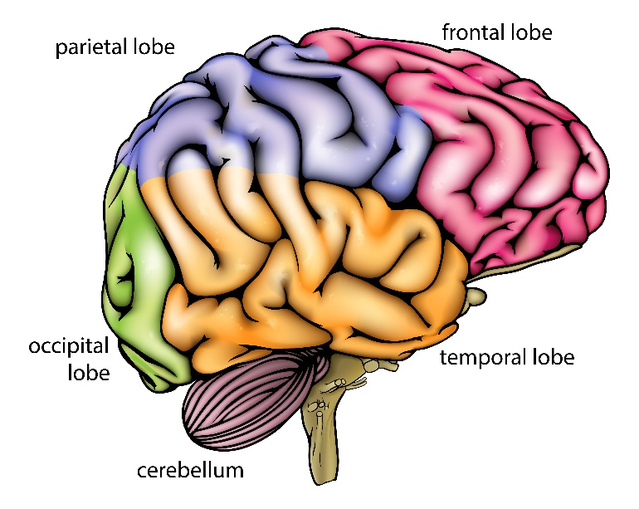
Causes and Triggers
Lewy bodies in the brain
Alpha-synuclein protein clumps together
causing the neurons to weaken and die.
affecting brains chemicals –
neurotransmitters that activate brain functions.
Symptoms depend on
the number of Lewy bodies.
where the Lewy bodies are in the brain.

Slide 14
Causes and Triggers
Health issues
Extreme tiredness, fatigue
Sleep disorders
Physical discomfort, pain
Fever, infections
Loss of autonomic functioning
Parkinsonism - movement problems
Problems with vision or hearing
Medication side effects

Slide 15
Causes and Triggers
Social interaction and communication
Inability to understand
Need to feel understood
Sense of loss
Fear
Need for attention
Reaction to negativity
Grief
Responses to hallucinations and delusions

Slide 16
Causes and Triggers
Environmental factors – the physical environment or task demands
Lighting ─ too dim; not enough visual contrast; too bright, painful to eyes
Noises, voices, sounds: loud, unpleasant, sudden, competing, or persistent
Temperature too hot or too cold
Unsafe environment (actual or perceived)
Objects that can be misinterpreted (mirrors, drapes, coat stands, art work, etc.)
A sudden change in environment (including a visit to the ER, hospitalization, transfer to a rehabilitation facility, a vacation, or move to a new home or long term care facility)

Slide 17
Causes and Triggers
Uncomfortable clothing
Over-stimulation or under-stimulation
Expectations too high or too low
A traumatic or distressing incident
Too many people in the immediate area or social isolation or lack of social support
Rough, abrupt, insensitive physical handling

Slide 18
Causes and Triggers
To the extent possible, include your loved one in identifying triggers.

Slide 19
Causes and Triggers
Are you a good detective?

Slide 20
Non-drug Strategies to Prevent/Curb Behaviors
Care partners can incorporate evidence-based, non-drug strategies into daily life.
may possibly prevent behavioral changes
may help curb challenging behaviors
are informed, person-centered, empathetic, and accepting
are part of responsive dementia care

Slide 21
Non-drug Strategies to Prevent/Curb Behaviors
Closely monitor the person’s physical health.
Create a safe and comfortable
home environment.

Slide 22
Non-drug Strategies to Prevent/Curb Behaviors
Establish and maintain a daily routine.
Make sure your loved one gets enough sleep.

Slide 23
Non-drug Strategies to Prevent/Curb Behaviors
Provide sufficient healthy and attractive food.
Be sure that your loved one stays hydrated.

Slide 24
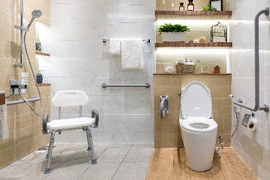
Non-drug Strategies to Prevent/Curb Behaviors
Make bathing/hygiene activities
pleasant, safe, and calm.
Avoid media with potentially disturbing content.

Slide 25
Non-drug Strategies to Prevent/Curb Behaviors
Communicate positively in a calm reassuring voice.
Engage your loved one in enjoyable
meaningful activities.

Slide 26
Non-drug Strategies to Prevent/Curb Behaviors
Identify people who trigger behavioral changes.
Incorporate one or more of the non-drug therapies.

Slide 27
Non-drug Strategies to Prevent/Curb Behaviors
What works for you?

Slide 28
Non-drug Strategies to Manage Behaviors
LBD experts recommend non-drug approaches as the first line of treatment.
to manage, reduce, or perhaps even eliminate many challenging behaviors
often as or more effective than drugs
avoid the adverse effects of many drugs
may take several attempts to find the best strategies

Slide 29
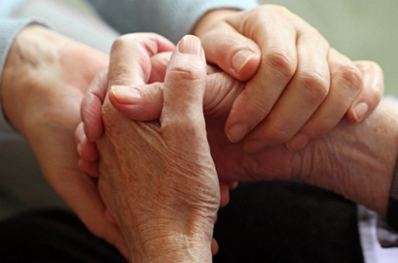
Non-drug Strategies to Manage Behaviors
Responsive care: A four-step process
Knowledge ─
Understanding how dementia changes the brain
Acceptance ─
Putting your own reality on hold and accepting theirs
Empathy ─
Imagining how you'd feel in their situation
Action ─
Being responsive, supportive, and person-centered.

Slide 30
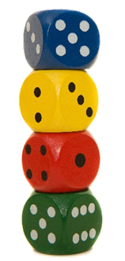
Non-drug Strategies to Manage Behaviors
Use a problem solving approach such as DICE.
Describe the details of the behavior: who, what, when, and where.
Investigate the causes of the behavior.
Create a plan to respond to behavioral issues.
Evaluate the outcome and changes needed.

Slide 31
Non-drug Strategies to Manage Behaviors
Don’t take any behavior personally. It’s Lewy not your loved one!.
Don’t argue; agree and validate your loved one's feelings.
Don't reason; accept your loved one's reality.
Don't defend; apologize. Yes! apologize. It works.
Don't correct; go with the flow.

Slide 32
Non-drug Strategies to Manage Behaviors
Redirect and distract; offer an enjoyable activity.
Use touch; gentle physical contact calms.
Stay positive; negative emotions block communication.
Take a time out; leave the room and come back later.
Stay calm; carry on.

Slide 33
Non-drug Strategies to Manage Behaviors
Only use strategies that maintain your loved one’s personhood with dignity and respect.

Slide 34
Non-drug Strategies to Manage Behaviors
Use “therapeutic fibbing.”
With dementia, comfort and peace are more important than honesty.
Respond from your loved one's reality.
Use words that don't worry or agitate - even if they aren't quite true.
Then use distraction or deflection. "Tell me about....“ For example, if a person wants to go home, say, “Let’s eat dinner first" and "Tell me about your home."

Slide 35
Non-drug Strategies to Manage Behaviors
OR be an improv actor.
Accept their reality and flow with it.
Listen with an open mind; respond to emotions more than words.
Agree verbally or non-verbally and accept your given role.
Stay in the moment, in the here and now.
Make contributions that slowly move the action towards your goal without conflict.
Use invitations, which include; not directives, which divide.
Give yourself permission to fail.

Slide 36
Non-drug Strategies to Manage Behaviors
Consult with your loved one’s health care team.
Don’t try to do everything yourself.

Slide 37
Non-drug Strategies to Manage Behaviors
Are you ready to…

Slide 38
Alternative Non-drug Therapies
Are used in combination with traditional medicine.
Often lead to the need for fewer drugs and a better quality of life.
Are safer and often more effective than many drug treatments.
Are person-centered with the focus on treating the whole person.
Make the person more comfortable and decrease stress and pain.

Slide 39
Alternative Non-drug Therapies
Physical therapy | General physical fitness
Occupational therapy | Speech therapy
Art therapy | Music therapy
Aromatherapy | Light therapy

Slide 40
Alternative Non-drug Therapies
Reminiscence therapy | Massage therapy
Pet therapy | Nutrition therapy
Light therapy | Validation therapy
Support groups | Individual and Family therapy

Slide 41
Alternative Non-drug Therapies
Which do you want to use?
Learn how to use each of the therapies and their benefits at www.lbdtools.com/events.php

Slide 42
See www.lbdtools.com/events.php
Presentation abstract
Presenters’ LBD background
Presentation poster
Presentation slide deck
Additional care partner resources on each topic

Slide 43
For More Information about LBD
www.lbda.org
www.lbdtools.com
www.lewybodydementia.ca
https://lewybodyresourcecenter.org

Slide 44
For Support
Face-to-face LBDA-sponsored support groups:
See https://www.lbda.org/lbd-local-support-groups?field_state_value=AK
Online support group for spouses of people living with LBD:
https://groups.io/g/LBDCaringSpouses
LBDA-sponsored online support group for people living with LBD:
https://www.facebook.com/groups/LBDALivingwithLewy/
LBDA-sponsored online support group for care partners of people living with LBD:
https://www.facebook.com/groups/LBDACarePartnerSupportGroup/
LBDA-sponsored online support group for people living with LBD and their care partners who are newly diagnosed with LBD and those who have early symptoms of LBD:
https://www.facebook.com/groups/LBDALivingTogetherwithLewy/?hc_location=group

Slide 45
To Use These Materials
LBD support group facilitators and others who provide educational and awareness activities may use these materials.
Please do not modify them.
Please include appropriate credit to the authors.
Please contact the authors if you have any questions.

Slide 46
Contact Information
Rosemary Dawson
LewyBuddyRo@gmail.com
703.501.4586
Helen and Jim Whitworth
thewhitworths@lbdtools.com
480.628.8356

